Slide 1
Title : Analysis of hand Gestures and Sign language Recognition.
Presenters:
Abhiram Sharma [2010030523]
N.Hemanth Srivathsav [2010030113]
Peri Vishwanadha Sastry [2010030470]
Vinay Kumar [2010030469]
Guide: Dr. Arpita Gupta

Slide 2
Table of contents
S.NO | TITLE
1. | Project Area
2. | Literature Survey
3. | Problem Statement
4. | Conclusion
5. | Suggestion
6. | End

Slide 3
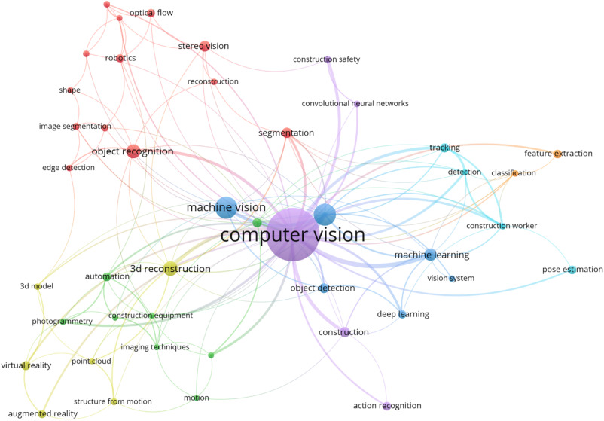
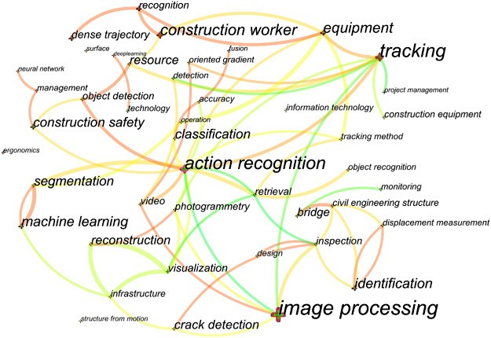
Project Area :
Computer Vision

Slide 4

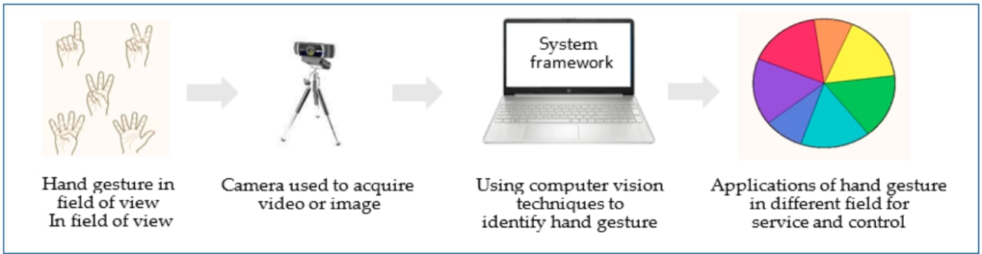
Gesture Recognition
Gesture recognition has been an on-going research driven
by its wide potential for applications such as sign language
recognition, remote control robots and human–computer
interaction in virtual reality

Slide 5
Problem Statement
Recognize Various Gestures and apply them as input to the computer
We decided to make 3 modules to our problem statement
as goals to be reached in our project
Module:
1
Train system for identification of gestures
Module:
2
Convert gestures into commands
Module:
3
Input commands to the Computer

Slide 6
Literature Survey
S.no | Authors | Title | Publishing | Techniques & dataset | Pros | Cons
1. | Pansare, J.R, Gawande | Real Time Static Hand Gesture Recognition for ASL in Complex Background. | Scientific Research - An Academic Publisher | T: RGB Threshold and edge detection D: A-Z hand gesture | 90.19% Recognition rate. | Only 26 static gestures.
2. | Pan et al. | Real time Sign Language recognition in complex background. | IEEE Publishing | T: SVM D: SIFT,Hu-moments and FD | ->99.8% Accuracy with CSL ->94% Accuracy with ASL | Based on Hierarchical clustering Classification Method

Slide 7
Literature Survey
S.no | Authors | Title | Publishing | Techniques & dataset | Pros | Cons
3. | Xiao Yan Wu | Hand Gesture Recognition algo based on DC-CNN. | Springer Link Publishers. | T:Canny Operator edge detection (DC-CNN) D:NAO Cam Hand posture database (NCD) | 98.02% Recognition rate. | Complex CNN layers and parameters.
4. | Tsoli, A.; Argyros | Joint 3D tracking of a deformable object in interaction with hand. | European conference on Computer Vision. | T: Bounding Box around the hand & hand Mask. D: Synthetic Dataset by blender modelling software. | Interaction with deformable object and tracking. | % of template vertices overall frames.

Slide 8
Literature Survey
S.no | Authors | Title | Publishing | Techniques & dataset | Pros | Cons
5. | Javier Molina, Jose Antonio Pajuelo & Jose M. Martinez | Real time Motion based Hand Gestures Recognition from Time of Flight. | Journal of Signal Processing Systems -Springer Link Publishers. | T:Depth info, motion patterns. D:cardinal direction Dataset. | Interaction with virtual environments | Depth range Limitation

Slide 9
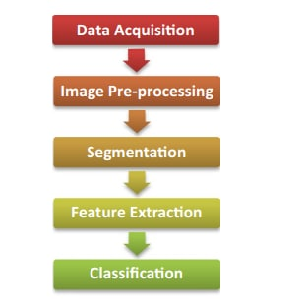
Conclusion
Sign language is an alternative method used by people who are unable to communicate with others by speech.
Alternatively, it may involve uncovered hand interaction with the camera, using computer vision techniques to identify the gesture.
Hand gesture recognition addresses a fault in interaction systems.
Controlling things by hand is more natural, easier, more flexible and cheaper, and there is no need to fix problems caused by hardware devices, since none is required.

Slide 10
THANK YOU

